Slide 1
Understanding Project Management Basics
Brian Vanderjack, PMP, MBA,PMI-ACP
© 2020 Brian Vanderjack

Slide 2
Terms
As is
Use at your own risk

Slide 3
Purpose
Define what a project is
Explain why we do projects
Define what project managers do
Define key terms using PMI’s words

Slide 4
Project Defined

Slide 5
Brian’s Definition of “Project”*
5
A planned, non-repetitive, well defined and finite effort to meet the documented expectations of a stakeholder community.
Planned; Has a project schedule
Non-repetitive: Not a process, do once and done
Well documented: Baselined requirements
Finite: Specific end date
Beneficial: Meets stakeholder’s documented expectations
* This definition is provided solely to start the conversation on project management. You will not see this definition on any exam in this course.

Slide 6
PMI’s Definition of Project (PMBOK 6th ed., p. 715)
“A temporary endeavor undertaken to create a unique product, service or result.”

Slide 7
Why Do We Do Projects?

Slide 8
Vision, Mission & Project Defined
The Vision:
The over-arching idea that the leader promotes, which when correctly conceived and stated, will drive people to invest themselves in making the vision come to fruition.
The Mission:
An expression of the vision that drives to a specific plan of action.
The Project:
Implements a part of the mission.

Slide 9
Concisely Stated
The Vision = the Why
The Mission = the What
The Project = the How

Slide 10
Example
The Vision = The leader of the organization wants humans to have access to good quality food, fast, all around the globe.
The Mission = The organization will build restaurants, in accordance with the vision
The Project = Build a restaurant, in support of the vision, at the corner of 31st and State Street in Chicago.

Slide 11
Example Visions
“To become the world’s most loved, most flown, and most profitable airline.” – Southwest Air
“Our vision is to create a better every-day life for many people.” – IKEA
“To be the best quick service restaurant experience. Being the best means providing outstanding quality, service, cleanliness, and value, so that we make every customer in every restaurant smile.” – McDonald’s
https://fitsmallbusiness.com/vision-statement-examples/

Slide 12
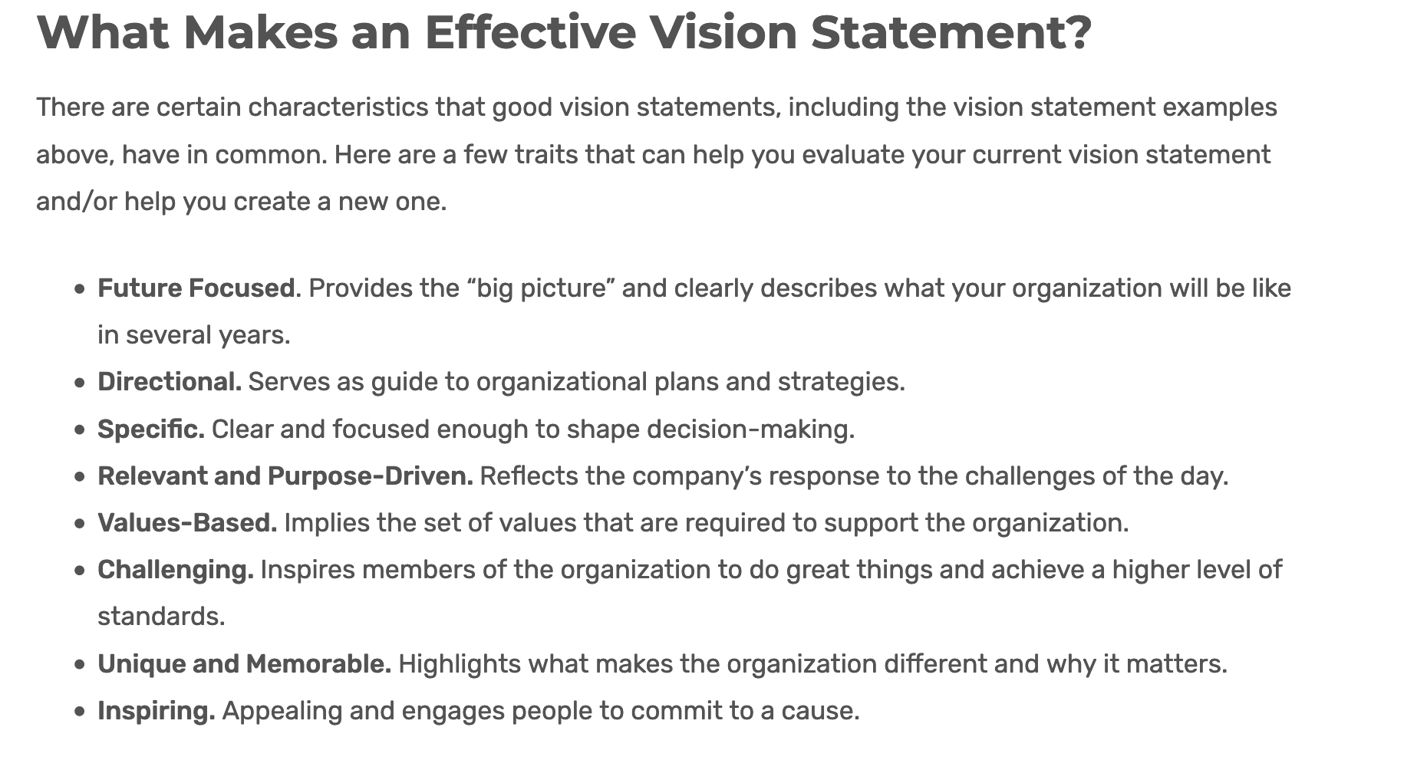
https://fitsmallbusiness.com/vision-statement-examples/

Slide 13
Core Competency: The key to organizational success
A Core Competency
Something the organization does amazingly well
Very hard for others to reproduce
Deliverables are valuable to customers
Once you have a vision, a core competency must be cultivated to maintain a competitive advantage.
Projects are how you enact, and continually improve, the components of your core competency.

Slide 14
Other Specific Reasons to Have Projects
1
Grow/strengthen competitive advantage
Legal mandate
Leverage new technology
Make money
Improve existing process
Public good
Competitive response
Money is in the budget
Marketing Life Cycle (see next slide)
Projects must support the organization’s vision and mission, or they will fail.

Slide 15
Below are the Stages of the Product Life Cycle
1
Introduction
Growth
Maturity
Decline

Slide 16


Example Product Life Cycle: Incandescent Light Bulbs
4
Introduction:
Growth:
Maturity:
Decline:
People willing to pay a lot, only wealthy people can get it (These wealthy people are called the innovators or early adopters.)
Mass production starts, price comes down, it is relatively easy to buy and more and more people buy it.
Only few don’t have it; marketing starts adding features to rebuild interest in product again (dimmable, soft-white, different shapes, etc.)
A new innovation comes along, making this product inferior (Spiral florescent lights and LEDs came along)
16

Slide 17
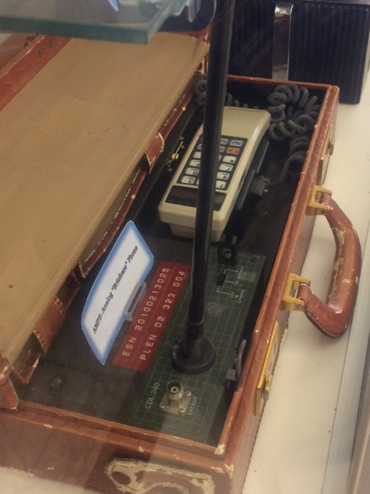

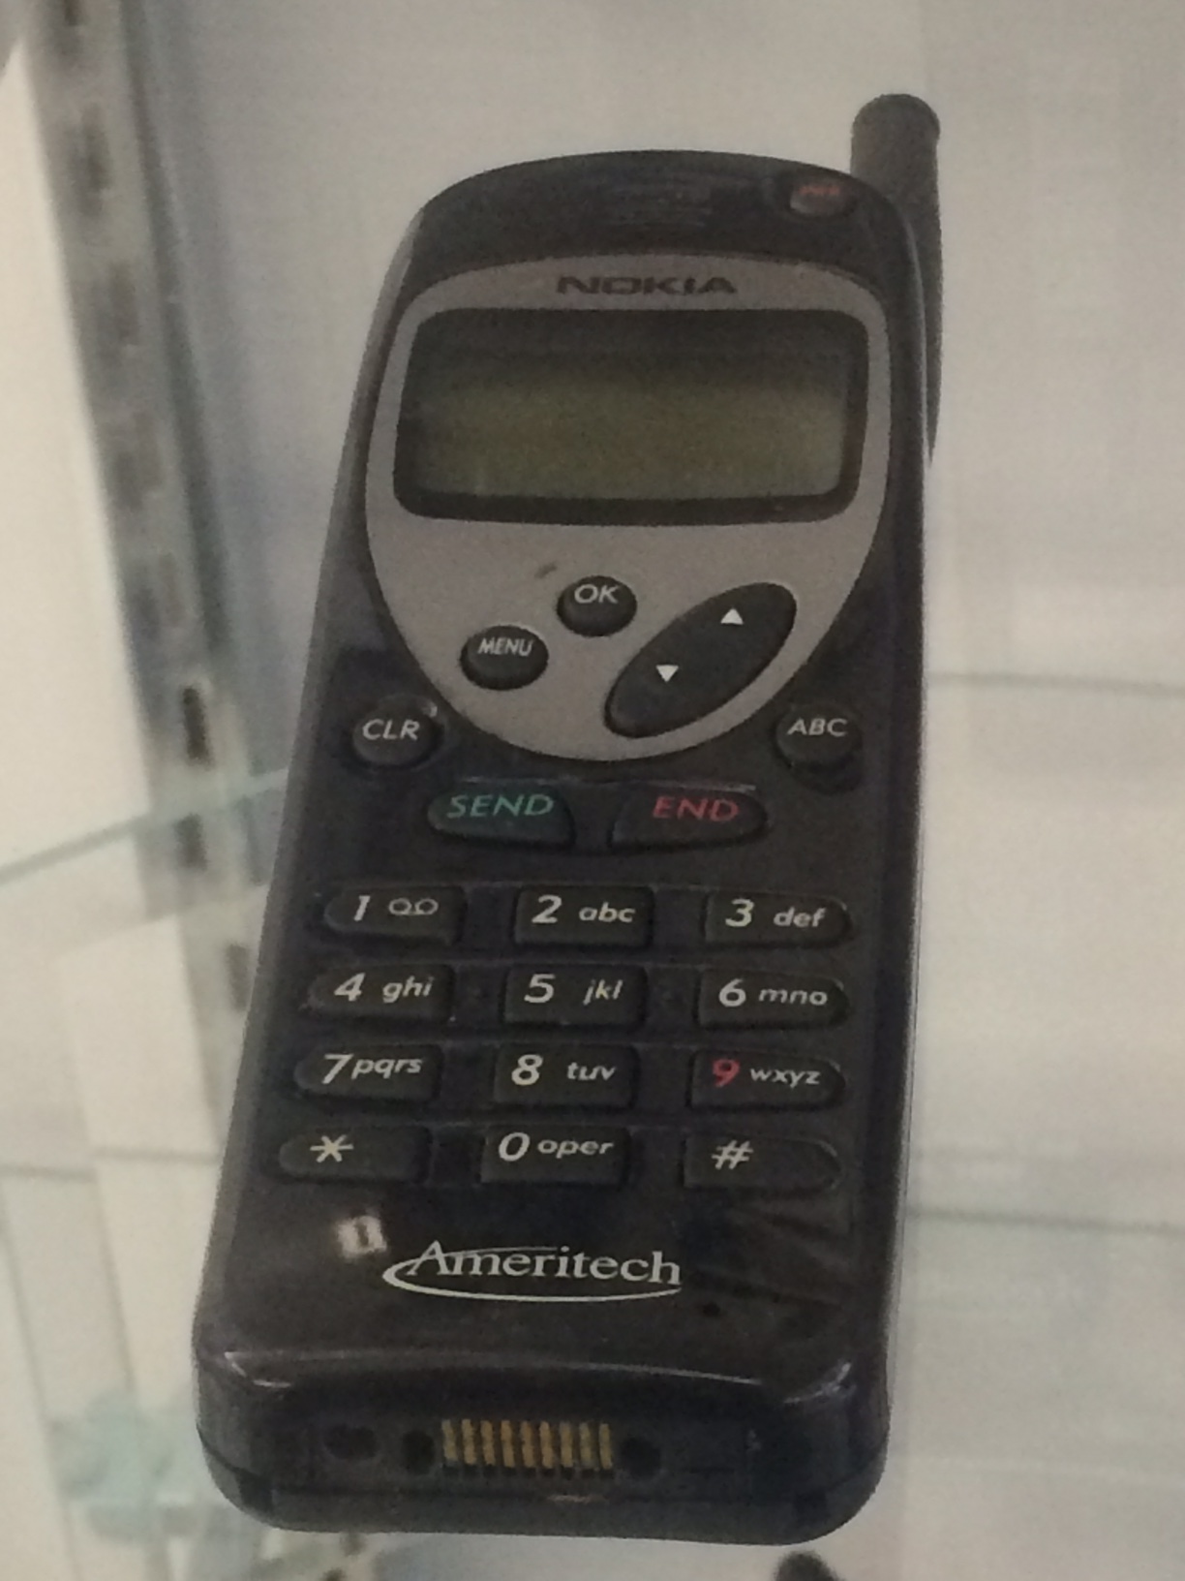
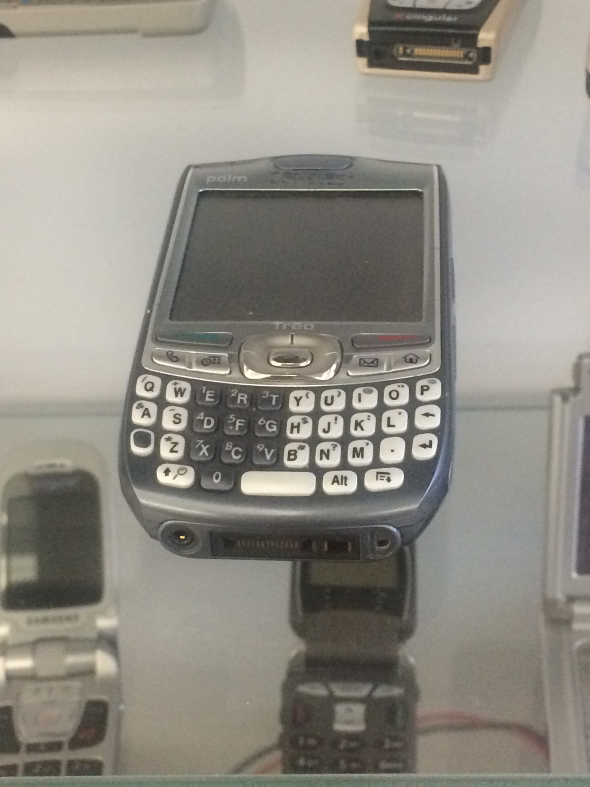

Slide 18
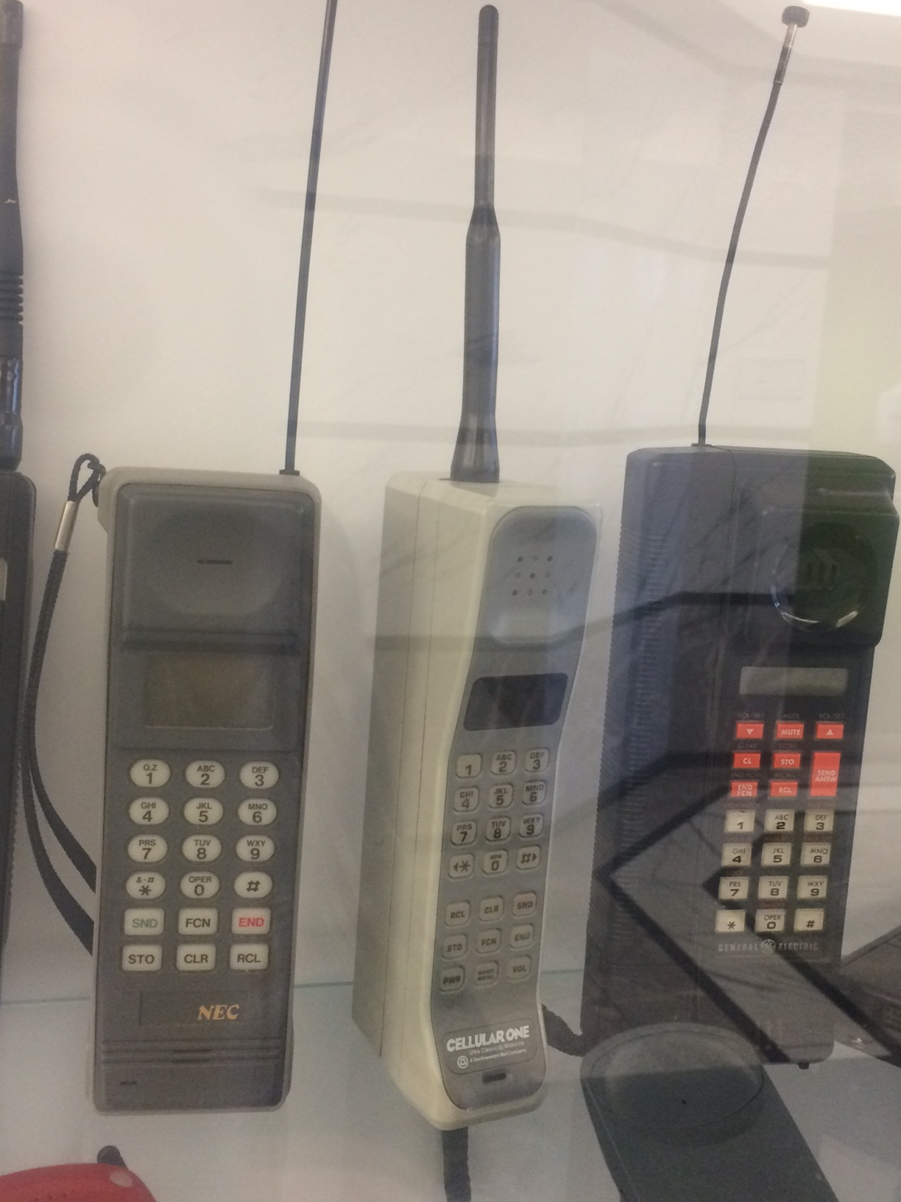


Slide 19


Source: Rafael Fernandez
As found on Wikipedia

Slide 20
What the Product Life Cycle has to do with Project Management
1
Project Managers
are
needed at each
step!
Introduction
Growth
Maturity
Decline

Slide 21
Project Business Case: Where a project starts
“A documented economic feasibility study used to establish the validity of the benefits of a” specific effort “that is used as a basis for authorization of further project management activities.”
(PMBOK 6th ed., p. 29)

Slide 22
Project Business Case: Some Components
Business Need:
Why is this project desired?
How does it support the organizational vision/Mission?
Description of prosed project.
Analysis of the Situation:
Critical success factors
Known risks
Identification of examined options, and option selection criteria used
NPV (if appropriate, assess financial viability)
Recommendation:
Proceed or not & why
expected due date
Evaluation:
Identification of factors that will be used to determine if the deliverable of the project is a success.
How will success measures be tracked, and who will they be reported to
(PMBOK 6th Ed, PP. 31-32)

Slide 23
These documents formally launch a project…
3
A Statement of Work (SOW)
and/or
Project Charter

Slide 24
PMI Definitions
Statement of Work (SOW): A narrative description of products, services, or results to be delivered by the project. (PMBOK 6th ed., p. 724)
Project Charter: A document issued by the project initiator or sponsor that formally authorizes the existence of a project and provides the project manager with the authority to apply organizational resources to project activities. (PMBOK 6th ed., p. 715)

Slide 25
4 Key
Considerations

Slide 26
The Iron Triangle
Quality
Time
Scope
Cost
(Kerzner, 2009, pp. 5-6)

Slide 27
The role of a project manager is to successfully balance the four key considerations; Time, Cost, Quality and Scope. A successful project will:
Be within an acceptable level of adherence to each of these 4 considerations (Time, Cost, Quality and Scope), as based on the stated needs of stakeholders who have the power to determine success.
The consumers of the project’s deliverables are satisfied.
The necessary resources for the project (technology, specific professional skills, unique materials, etc.) are available to the project team when they are needed*
(Kerzner, 2009, pp. 5-6)
*Though not a part of the Iron Triangle, this was added because in the PMBOK 6th ed., on p. 10, “resources” are specifically mentioned along side of Time, Cost, Quality and Scope.

Slide 28
PMI’s Definitions as found in the PMBOK 6th Ed.
Cost: “Project Cost Management should consider the effect of project decisions on the subsequent recurring cost of using, maintain, and supporting the product, service or result of the project” (p. 233)
Quality: (p. 718) The degree to which a set of inherent characteristics fulfills requirements. *
Scope (p. 722) The sum of the products, services, and results to be provided as a project.
Time: A limited period or interval, as between two successive events **
* To PMI, just meeting requirements as a core success criteria. Modern quality experts establish the expectation customer satisfaction. For example, and according to Juran, meeting expectations regarding fitness of use is the definition of quality.
** Dictionary.com – 4th definition

Slide 29
Specifically on the Project Manager’s Role (PMBOK 6th ed p. 52)
Possess understanding, knowledge* and experience
“Provides leadership”*
Coordination through communication;
Existence of requirements (BV)
Planning, including project schedules (Gantt charts/ MS Project)
Monitor/control (BV)
SMART Goals/Metrics/KPIs Project execution
Project’s outcome
The PM does not need to be an expert! (BV)
.* See future slide in this section

Slide 30
Specifically on the Project Manager’s Role (PMBOK 6th ed p. 52)
Knowledge:
Technical
Project management
Understanding
Experience

Slide 31
PMI On Leadership (PMBOK 6th ed. P. 60)
For a team:
Guide
Motivate
Direct
PM’s Leadership Abilities (in no order –BV):
Communication
Interpersonal skills
Problem solving
Negotiation
Critical thinking

Slide 32
A Few Words From
PMI on Projects

Slide 33
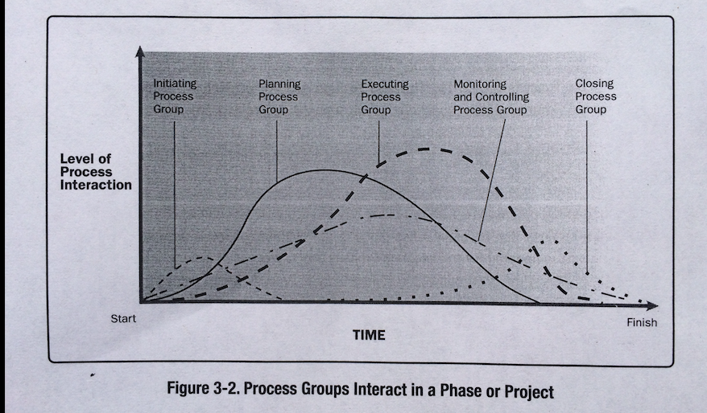
PMBOK 5th Ed, p. 51.
See next slide

Slide 34
More detail on process groups
https://projectmanagementacademy.net/articles/five-traditional-process-groups/

Slide 35
Project Manager Responsibilities Defined
(PMBOK 6th ed., p. 52 & p. 716)
“The project manager is the person assigned by the performing organization* to lead the team that is responsible for achieving the project objectives.”
*This definition assumes the entire company is the “performing organization.”

Slide 36
SMART + Lexicon Use Example
Related Lexicon (new words)
Program
SMART
Specific
Measurable
Achievable
Realistic / Relevant
Time bound

Slide 37
A word on goals
Metrics are just a way to measure
Goals need to be flexible to allow for unique situations
SMART goals are needed to make metrics meaningful
Goals provide context for metrics

Slide 38
Stakeholder Defined (PMBOK 6th ed., p. 723)
“…an individual, or group, or organization that may affect, be affected by, or perceive itself to be affected by a decision, activity, or outcome of a project…”

Slide 39
Summary

Slide 40
You Don’t Need Formal Management to Get Results, but…
3
Using generally accepted project management techniques will increase the chances of a success.
If a project fails, a project manager who follows generally accepted project management principles, will be more likely to keep their job.

Slide 41
Summary
Defined what a project is
Explained why we do projects
Defined what project managers do
Defined key terms using PMI’s words

Slide 42
Understanding Project Management Basics
Brian Vanderjack, PMP, MBA,PMI-ACP
© 2019 Brian Vanderjack

